Slide 1

vision for 2024
Thursday, 28 March 2024
18:21

Slide 2








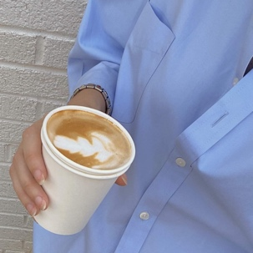





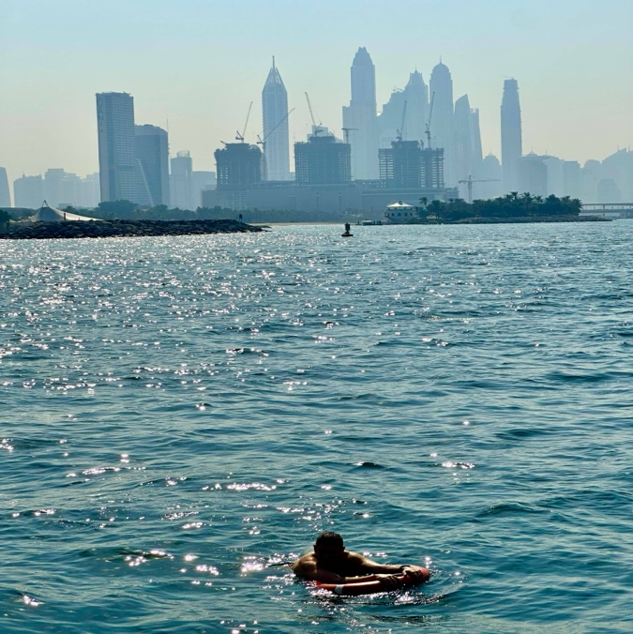


18:21
Thursday, 28 March 2024
daily reminder
KeePer
The Boyz
create a life you can’t wait to wake up to
Improve sleep schedule
Reduce screentime
Learn how to surf
Read 20 books
Communicate and express myself
DON’T WISH FOR IT, WORK FOR IT
5
Goals

Slide 3
Reading list
Thursday, 28 March 2024
Becoming What You Are
12 Rules For Life
Feel the Fear and Do It Anyway
The Most Important Thing
Zero To One

Slide 4
Goals for 2023
My lists
My Lists
🦋
Goals for 2023
Intentions
Watch list
5
8
47
◯ | Improve my sleep schedule, wake up by 7
◯ | Reduce screentime
◯ | Learn how to surf
◯ | Read 20 books
◯ | Communicate and express myself more clearly
🧠
🍿

Slide 5


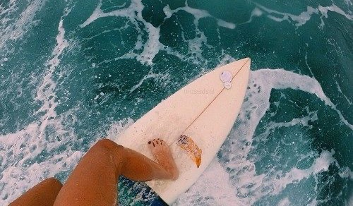


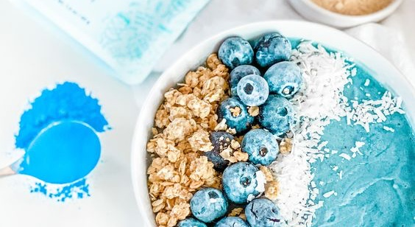




Vision board for 2024

Slide 6

The best way to predict the future is to create it.

